Slide 1

Albany Police Department Quarterly Update
Jan. 1st-Mar 8th

Slide 2
Operational Update
15,908 Calls for service (Jan 1st-Mar 8th)
  11,067 Citizen Calls
  4,841 Officer Initiated Calls
Incident Data
  Part I Crimes – 787
  Part II Crimes – 1,304
  616 Individuals Booked into DOCO Jail, accounting for 594 incidents
Traffic Accidents – 884
  0 Fatalities
  7 incidents DUI

Slide 3
Community Relations Unit
Revamped efforts to continue our community efforts
Using existing resources to spread influence to all areas of the city
Keeping a thumb on the pulse of the community
Using intervention and prevention methods

Slide 4
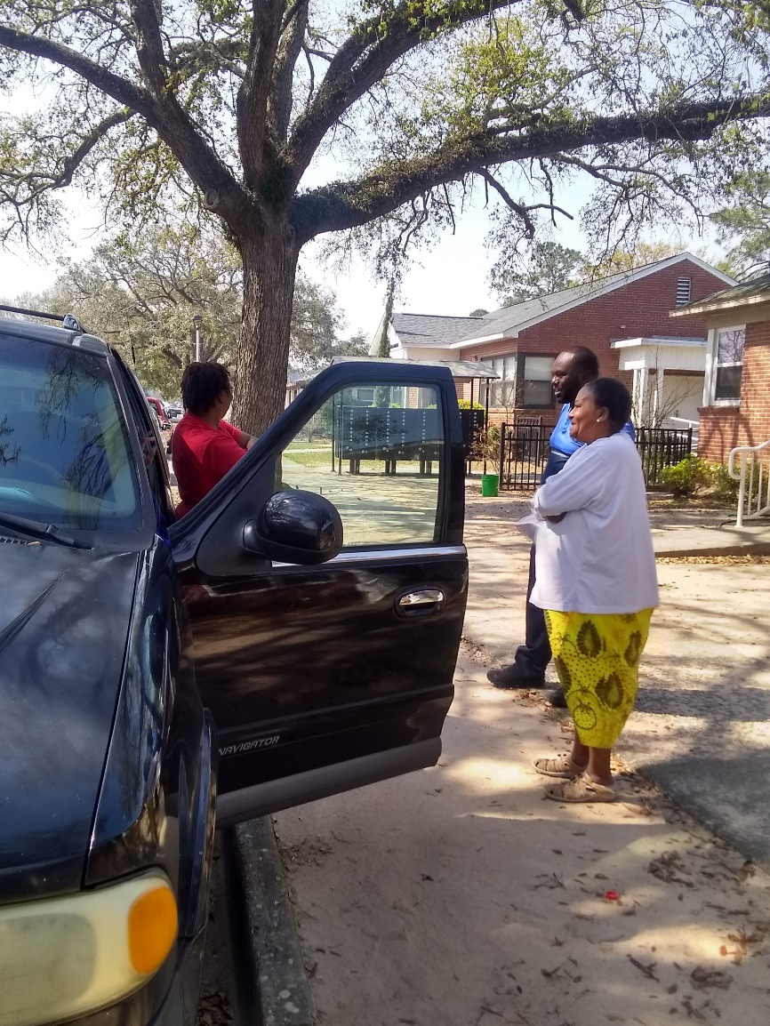
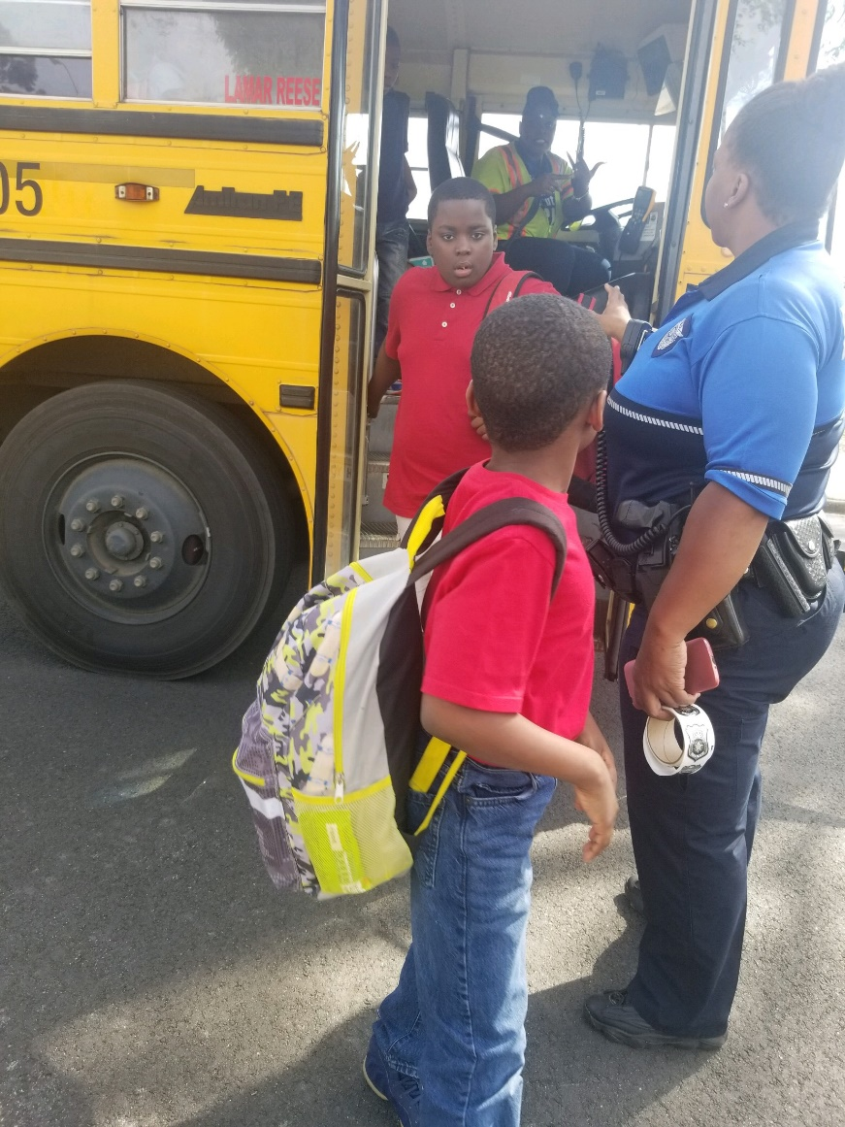
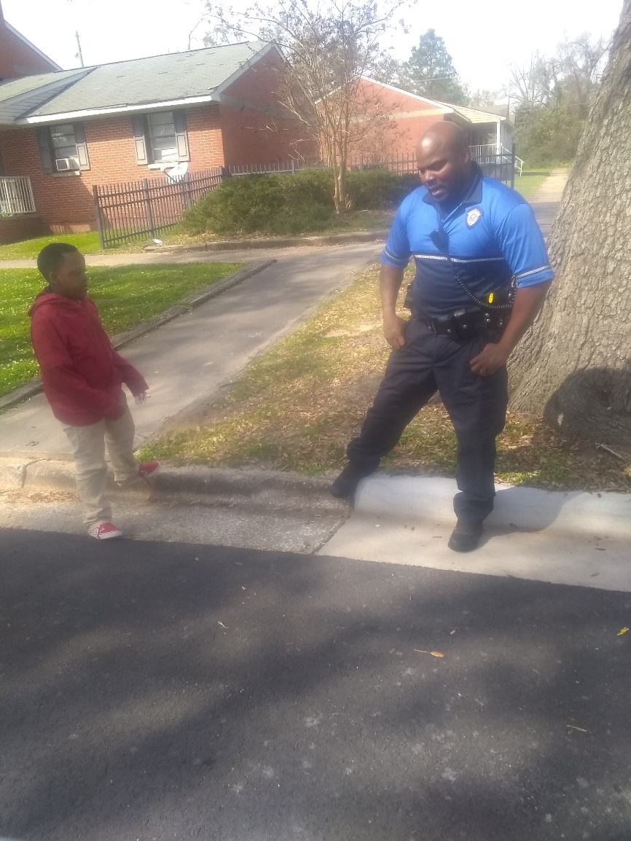
Neighborhood Resource Officers
One neighborhood at a time

Slide 5
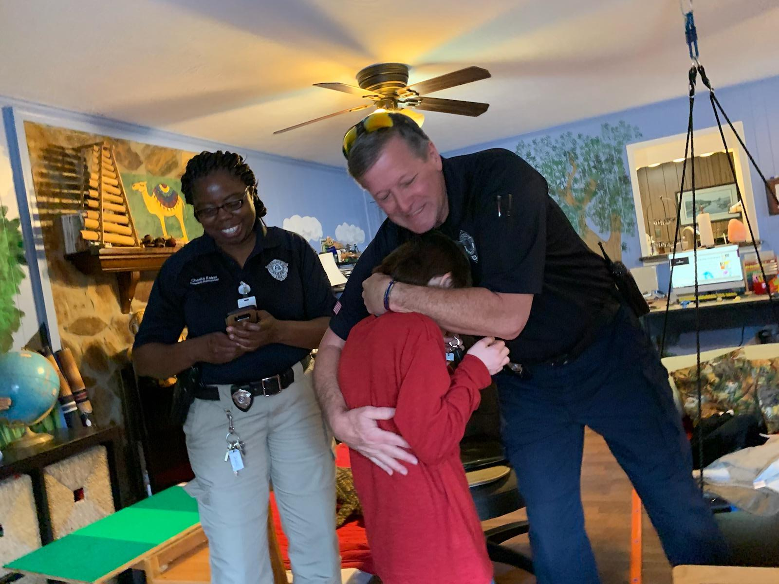
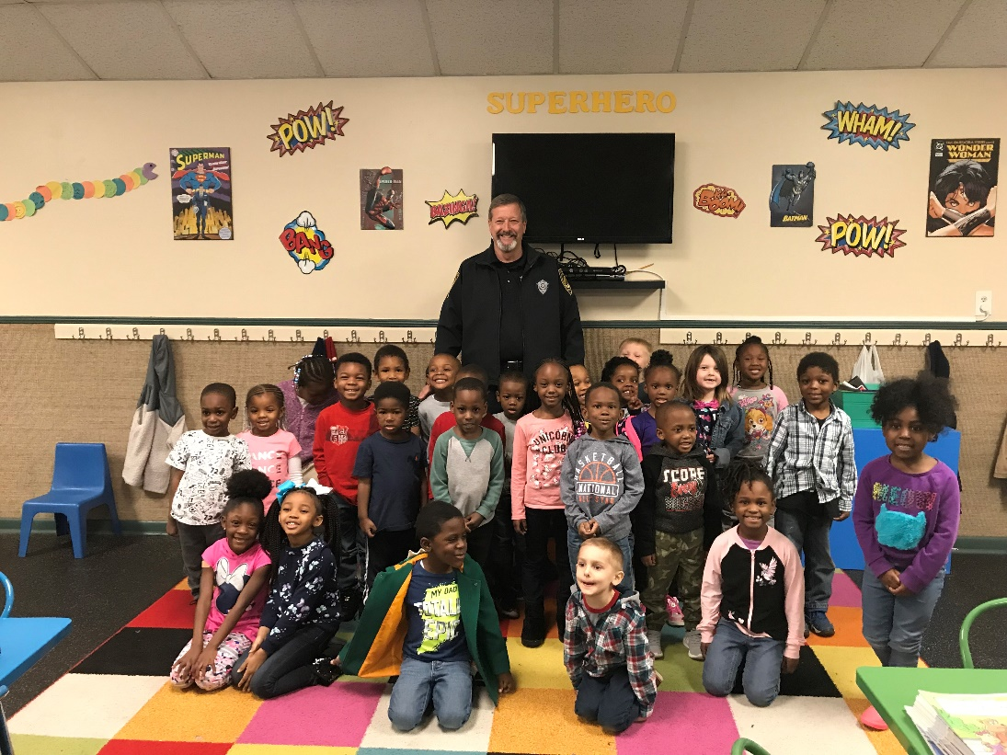
Crime Prevention Unit
Focusing on our future by investing in the children

Slide 6
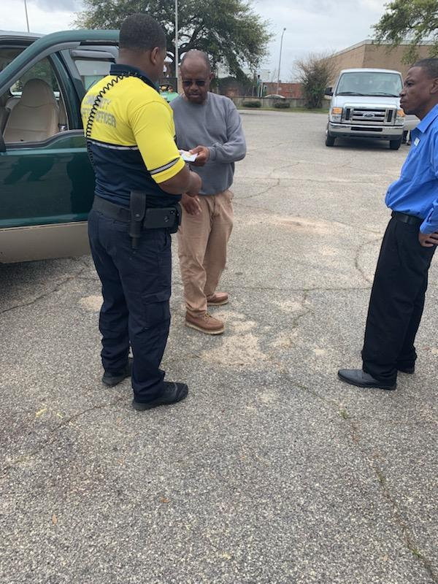
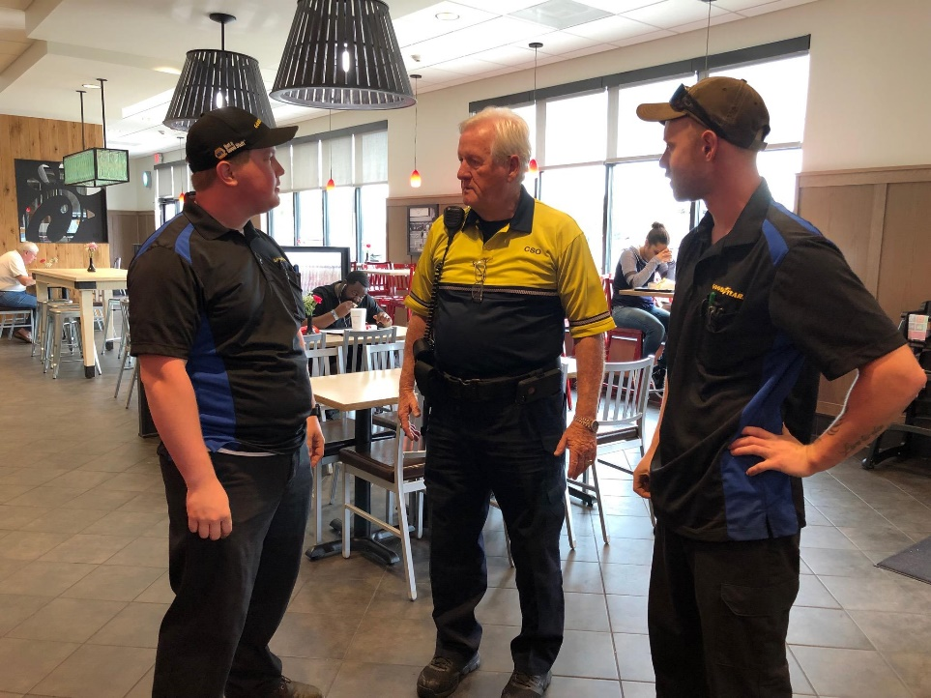
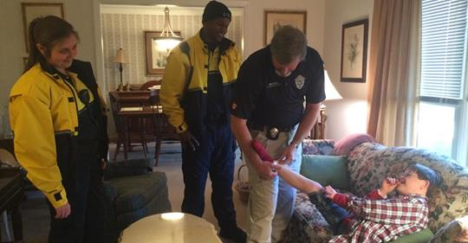
Community Safety Officers
Serving the citizens in a variety of situations

Slide 7
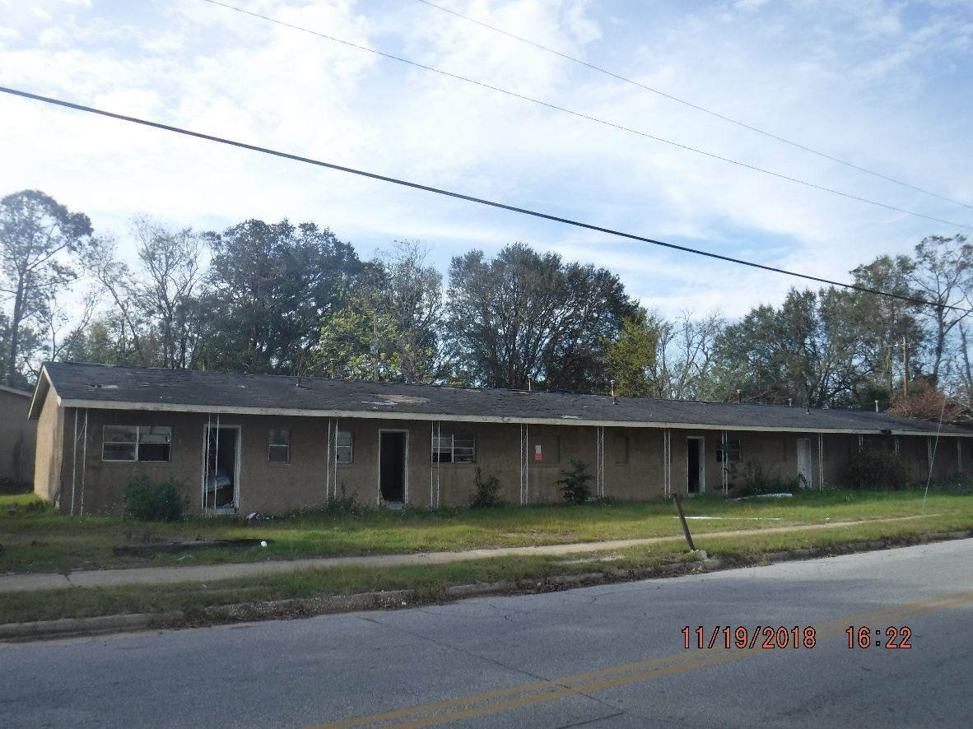
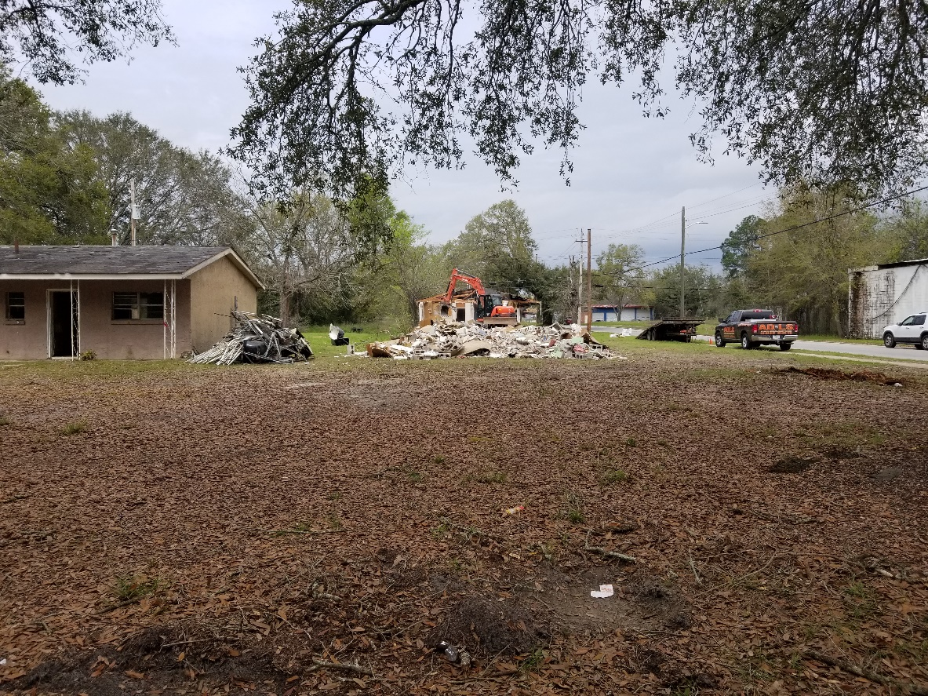
Code Enforcement success
Taking Action
Cleanup (Almost) Complete

Slide 8
What else have we done?
Worked with the USAO Middle District of GA on PSN cases
Supported Criminal Justice Forum w/Comm. Howard
Re-established Chaplain Program
Supported Read Across America programs in DCSS

Slide 9
Going forward
Continue to rely upon citizen support to keep our community safe
Focus on Part II crimes and quality of life concerns
Use all available resources to identify and arrest offenders
Continue to support various community organizations

Slide 10
Questions

